Slide 1

Presentation Skills

Slide 2
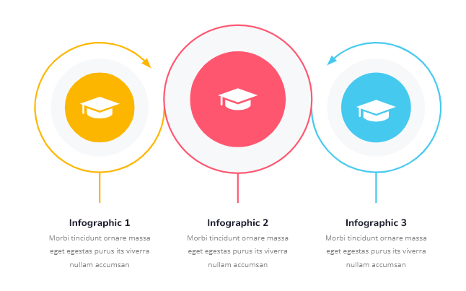
Introduction

Slide 3
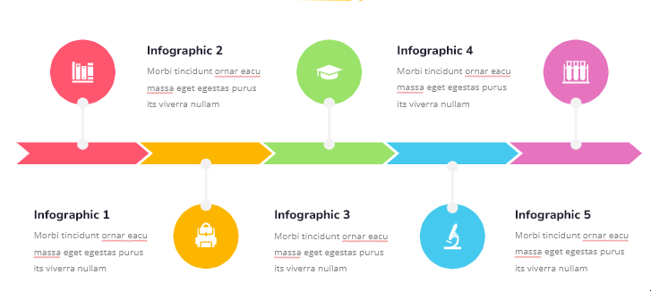
Learning Objectives

Slide 4

The Four Types of Presentation
There are four kinds of presentations: informational, instructional, stimulating, and convincing.

Slide 5
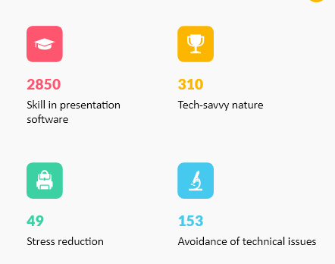
About Us
Technical Skills

Slide 6

Assessments
Check Your Understanding
Q1. Which of the following is the most important part of using presentation skills? A. Planning B. Preparation C. Visualizing success D. Exercise/drinking water beforehand

Slide 7
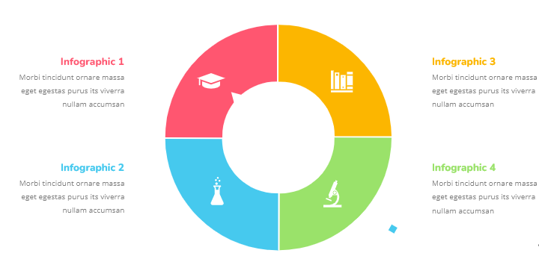
Key points

Slide 8



References
Additional Resources
References
Start Learning

Slide 9

Feedback
Course Evaluation
Kindly spare a few moments to fill out the course feedback form.
Submit

